Slide 1
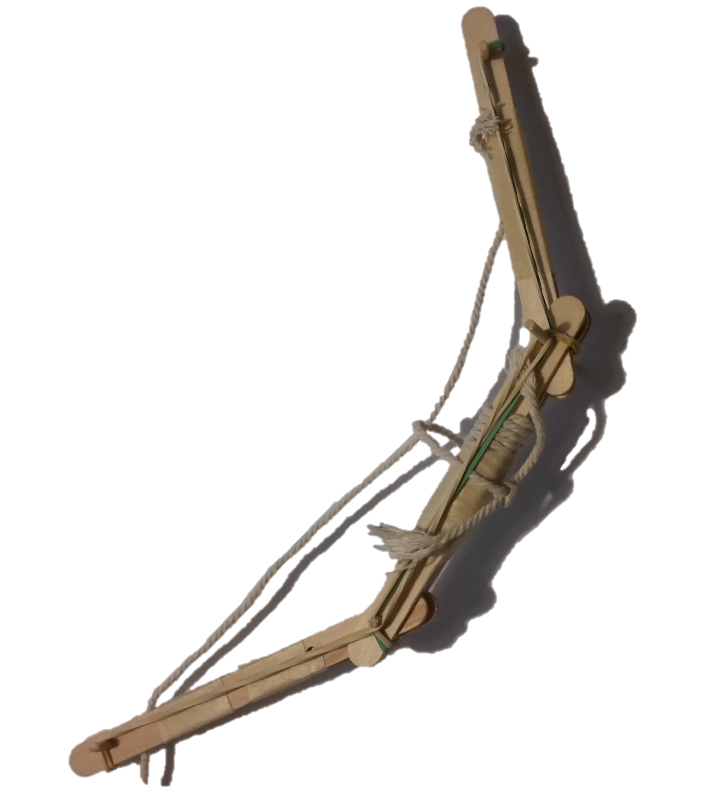
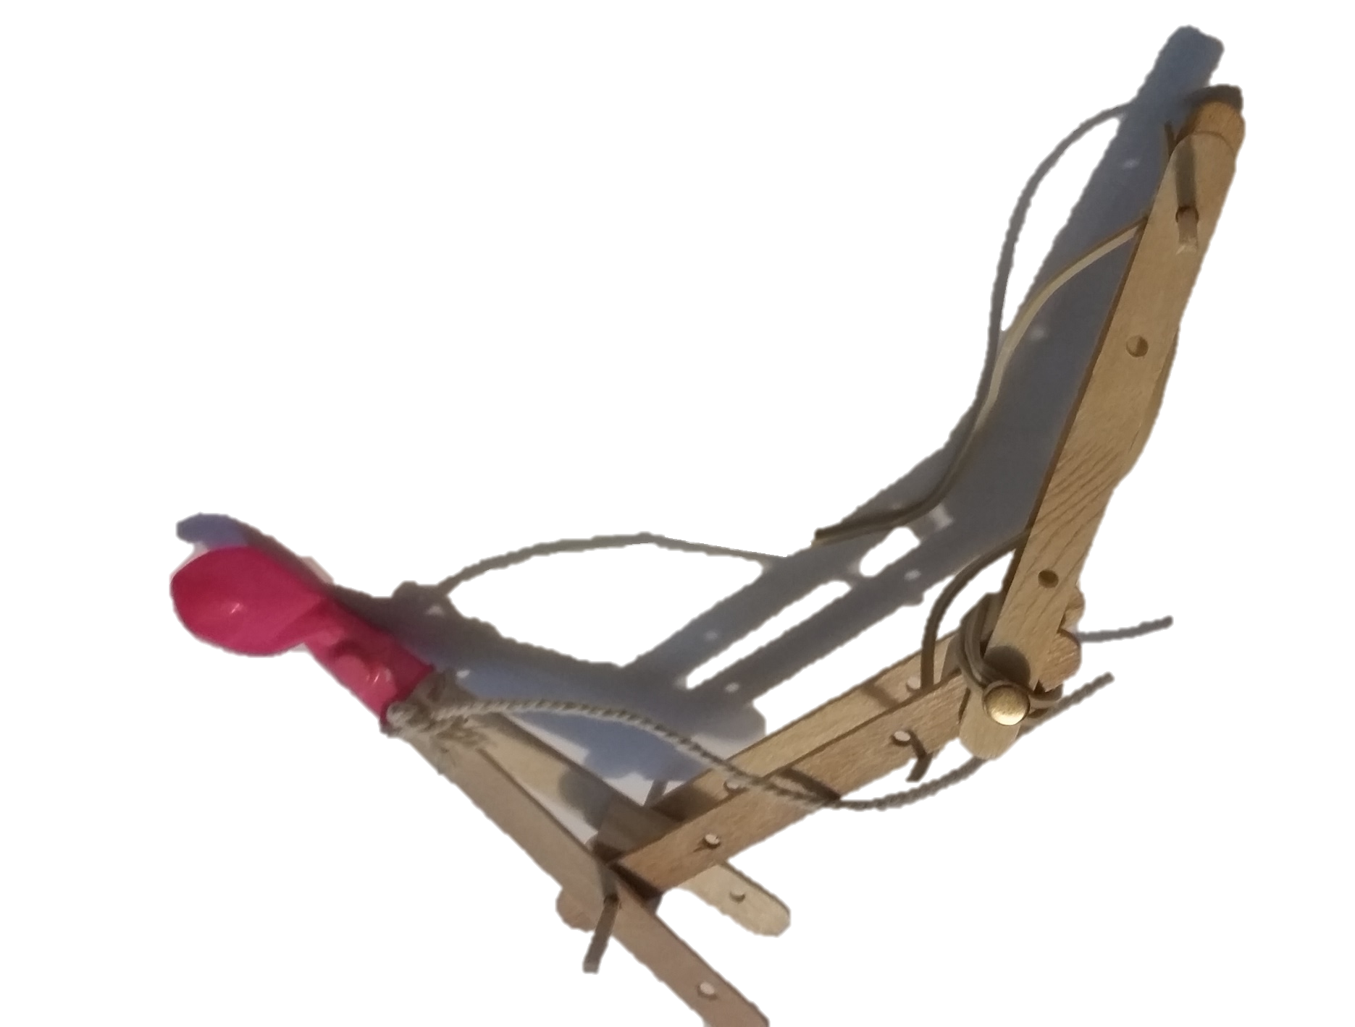
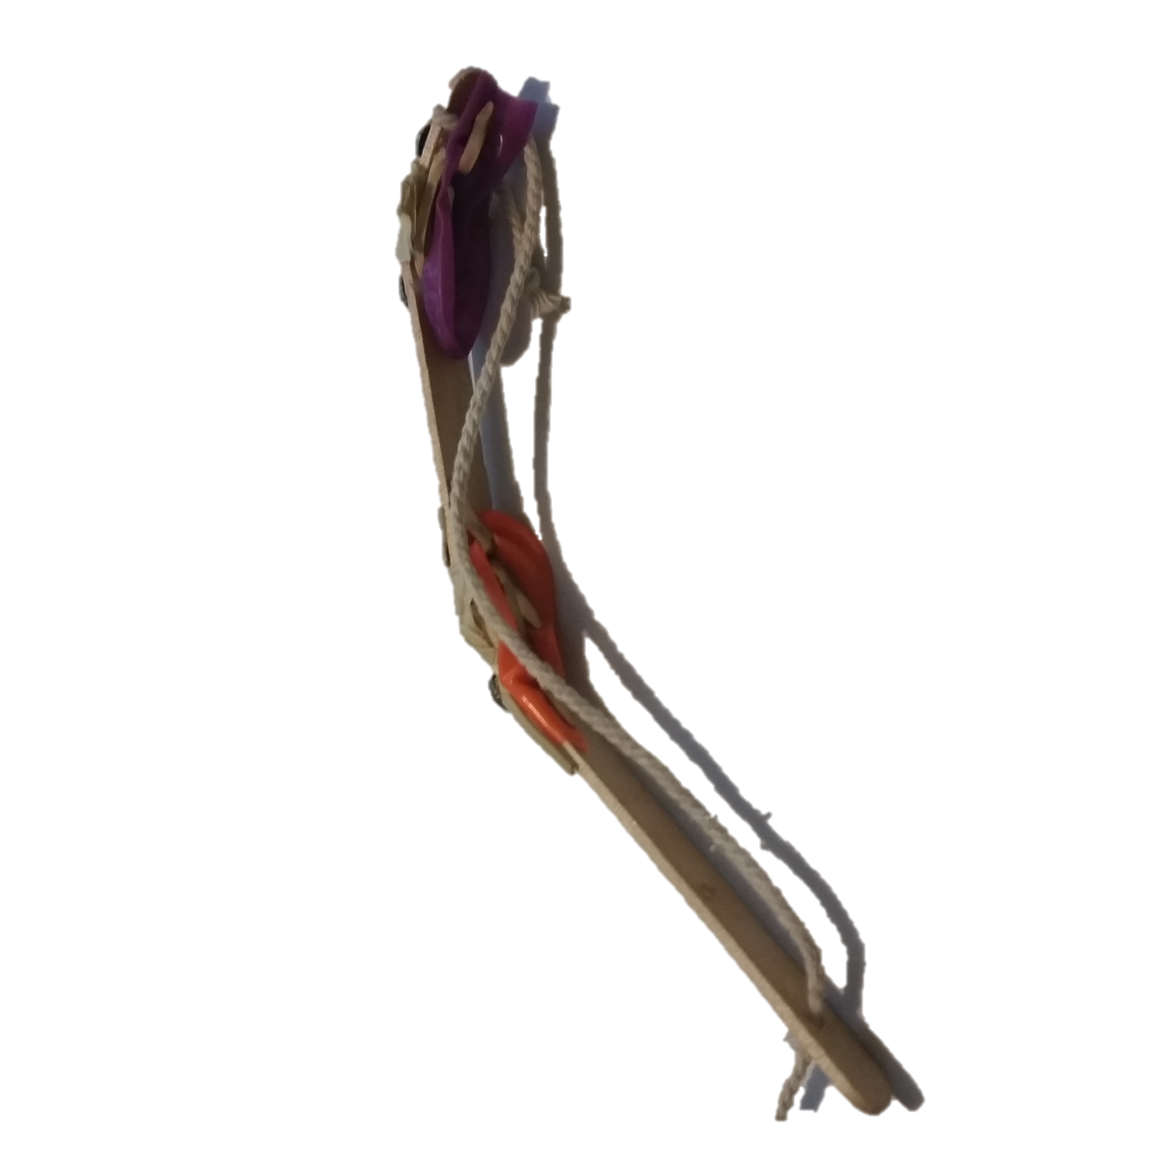
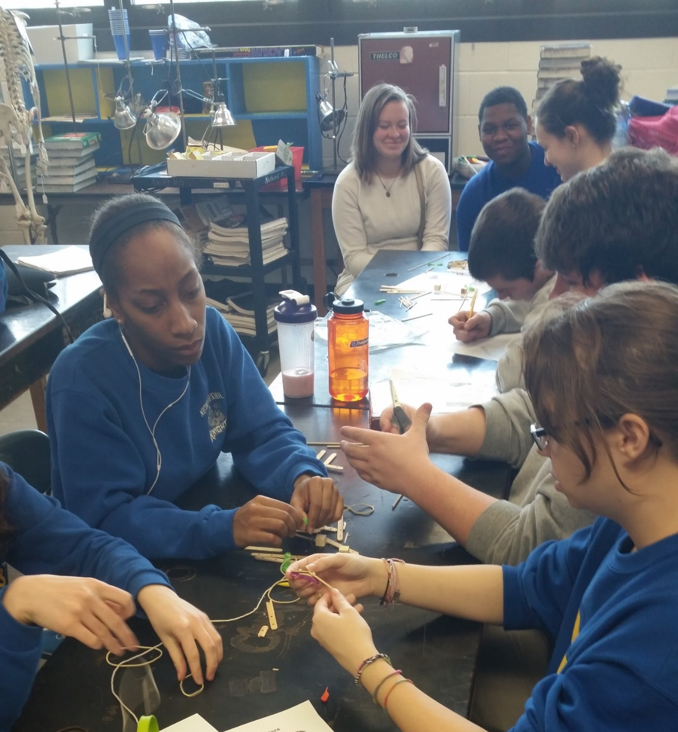
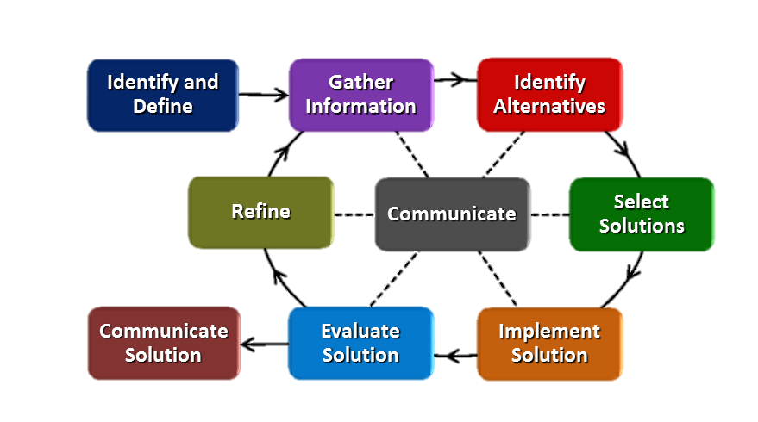
Engineering Using Nature’s Template Andrew Fisher Northwest High School, Anatomy and Physiology
RET is funded by the National Science Foundation, grant # EEC 0808696.
Unit Overview
Activity Implementation
Student Work
Topic: Engineering solutions based on items found in nature, and particularly human anatomy.
Standards: Students will be able to…
Describe the functions of the human skeleton
Describe the macroscopic structures of the long bone and their functions
Define and identify muscles origins and insertions
Describe muscle movements and provide examples
Identify structures and functions of the human eye
Day 1: The Anatomy of the Camera - This presentation focused on how the human eye is very similar to the digital camera. Also, the end of the presentation talks about some human inventions that are influenced by nature.
Day 2: Modeling a Human-Like Finger- This activity involved designing and building a human like finger out of common craft items. These items included popsicle sticks, skewers, rubber bands, string and more.
Assessment Results:
Impact on Student Learning
Activity Structure
Title: Modeling a Human-Like Finger and The Anatomy of the Camera.
Guiding Questions:
What are the parts of the eye and the camera?
What do the human eye and the camera have in common?
What inventions have mimicked nature?
How do engineers use the human form to influence their designs?
Objectives:
Identify the parts of the eye that correspond to the parts of a camera
Trace the flow of light through a camera
Name inventions that mimic nature
Design and build a model human finger.
Engineering Design Process
Reflection and Conclusion
The Engineering Design Process (EDP) was not used in its entirety, because of the limited timeframe. However students were still asked to design a solution before the implementation. EDP calls for a refinement phase, however this was eliminated because of time. This activity shows that the use of “nature’s template” is a real world practice
in engineering. When executing the
activity students will hopefully gain an
understanding of what researchers in
the field of anatomy can do while working
with engineers on real world applications.
My activity was successful, the two day application was exactly as planned. However if I was to do this again I would consider the following points.
Introducing background knowledge on electricity
Playing up the refinement stage of the EDP
Giving more examples / guidance to students during the finger activity.

